Slide 1
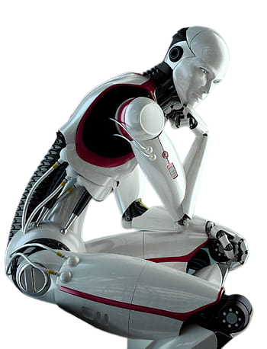
HUMANIOD ROBOTS
Name : D. Lalitha Prasanna
Regd. No. : 23MTS0013

Slide 2
CONTENTS
What is Humanoid Robots?
History of Humanoid Robots
WABOT 1
WABOT 2
ASIMO
Few Humanoid Robots
Further Development
Characteristics
Advantages & Disadvantages
Applications
Future Scope
Conclusion
References

Slide 3
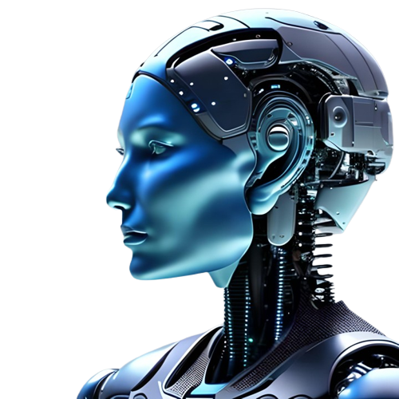
WHAT IS HUMANIOD ROBOTS?
Humanoid robots are professional service robots built to mimic human motion and interaction
It is similar to all the service robots.
They provide value by automating tasks in a way that leads to cost-savings and productivity

Slide 4
HISTORY OF HUMANOID ROBOTS
The first humanoid robot was a soldier with a trumpet, made in 1810 by Friedrich Kaufmann in Dresden, Germany.
Karel Capek coins the term “Robot” – 1921
1930’s to 70’s: Theory of humanoid shapes, electronics and movements
Not until 1970’s a practical autonomous Robot of this type
Boom in development from 1980 to present

Slide 5
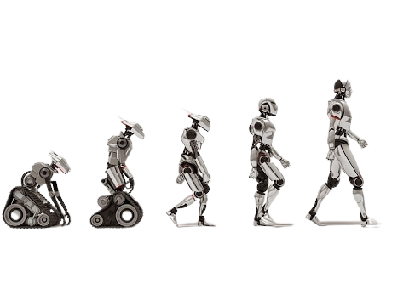
EVOLUTION

Slide 6
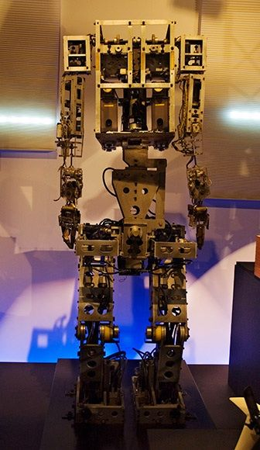
WABOT – 1 (1970~1973)
It was developed by Waseda University
The first humanoid robot developed in the world.

Slide 7
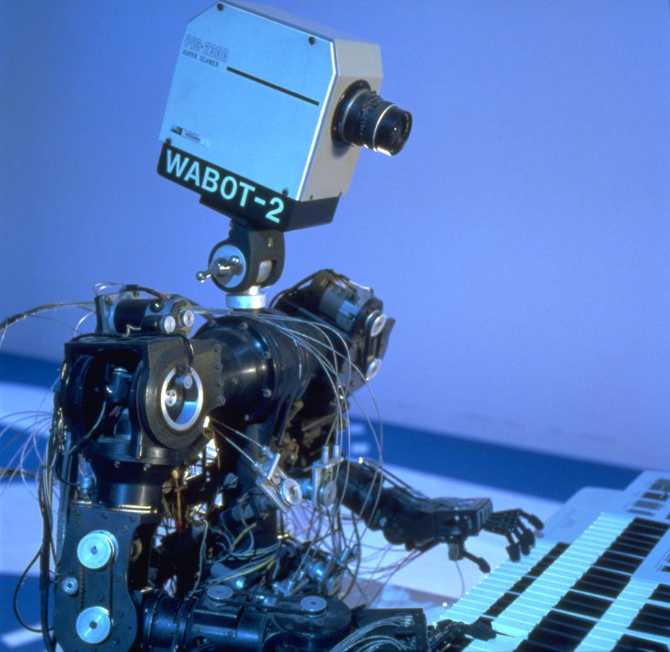
WABOT – 2 (1980~1984)
It was developed by Waseda University.
This robot is a specialist robot.
This is popular as “Robot musician”.

Slide 8
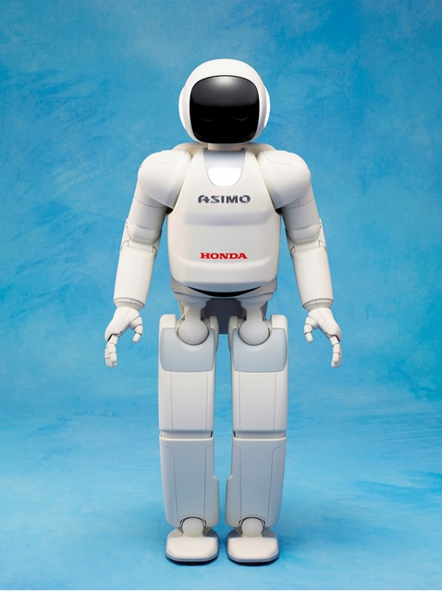
ASIMO
It was created in 2000 b Honda.
ASIMO – Advanced Step in Innovative Mobility.
It is the 4th man like humanoid robot.
It understand human gestures and movements.

Slide 9

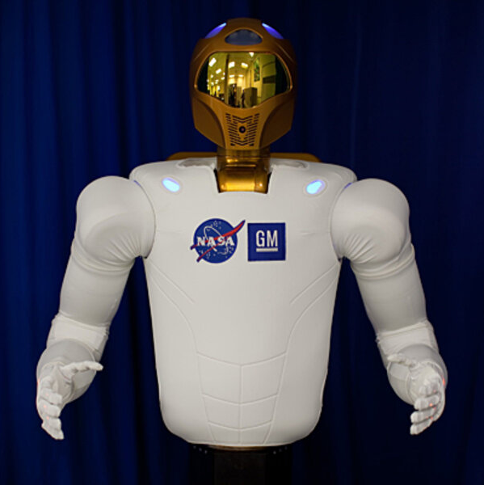
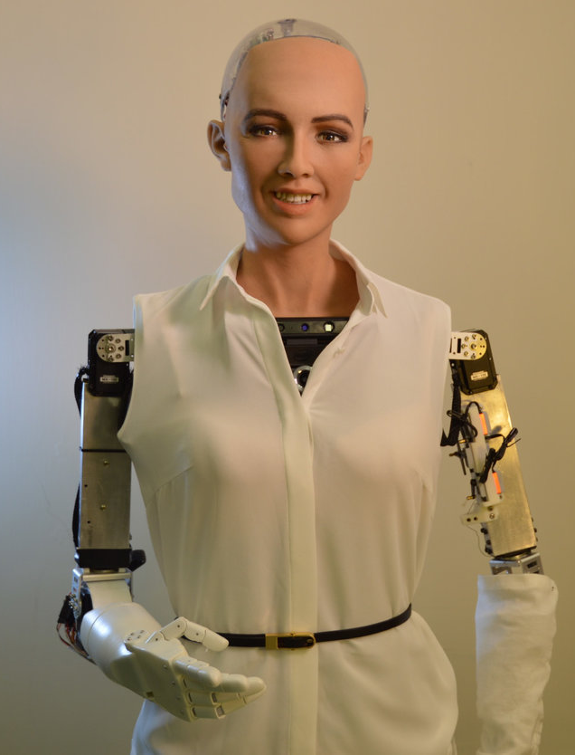
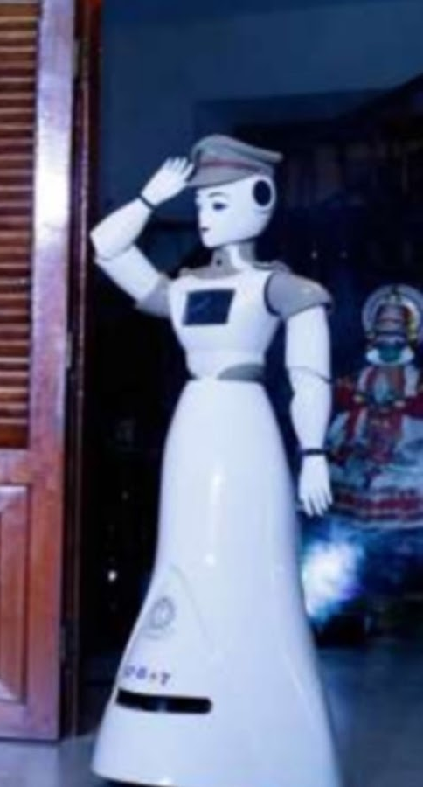
FEW HUMANIOD ROBOTS
Sophia
RoboCop
Rashmi
Robonaut

Slide 10
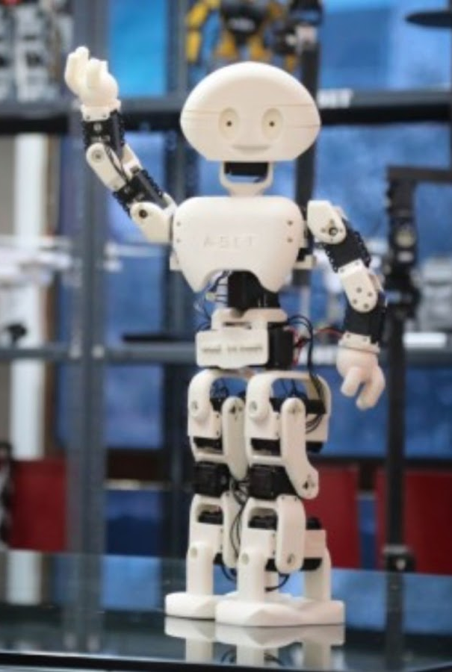
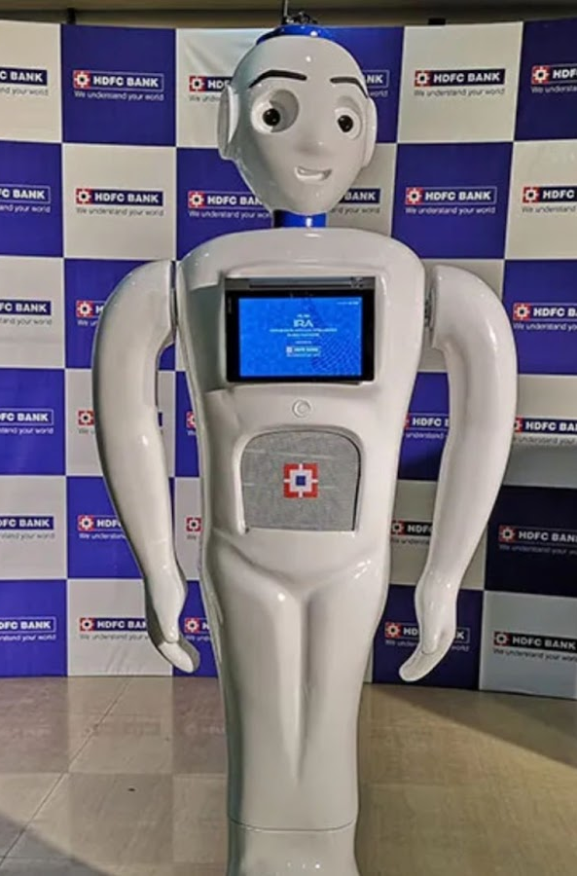
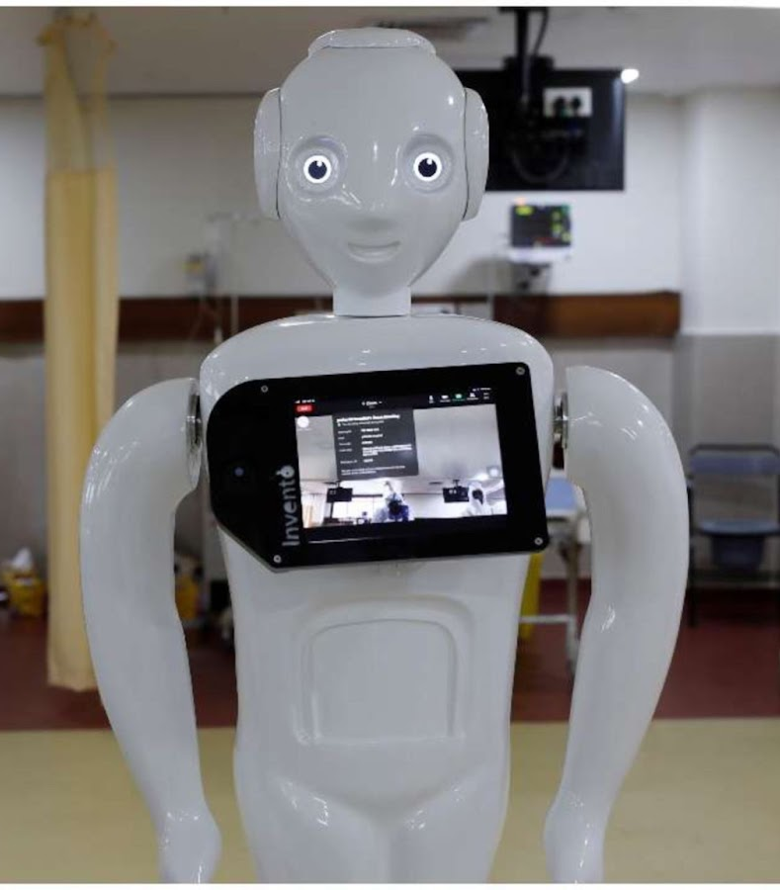
Manav
IRA
Mitra

Slide 11
FURTHER DEVELOPMENT
1985 – Hitachi’s WHL-11
1986-1991 – Honda’s E series
1989 – Pacific Northwest Laboratories’ Manny
Present Day: Honda, Hitachi, Military intuitions, NASA compete with designs

Slide 12
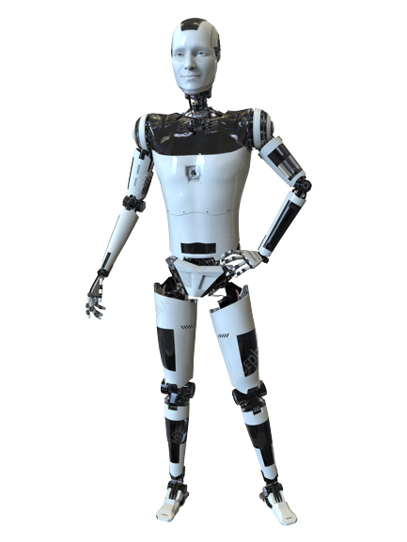
CHARACTERISTICS
Self-maintenance.
Avoiding harmful situations to people, property and itself.
Safe interacting with human beings and the environment.
Arm control and dexterous manipulation.
Legged locomotion.

Slide 13
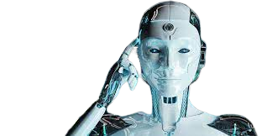
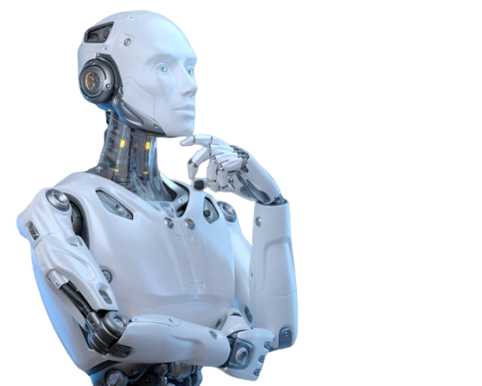
ADVANTAGES & DISADVANTAGES
ADVANTAGES
Good efficiency
High accuracy
Less time consuming
Self interacting
DISADVANTAGES
Hard to implement
High cost
Requires specialized people for maintenance

Slide 14
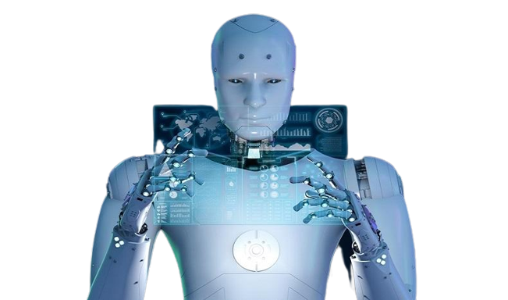
APPLICATIONS
Manufacturing and maintenance
Research
and
space exploration
Search
and
rescue
Personal assistance
and
caregiving
Education
and entertainment

Slide 15
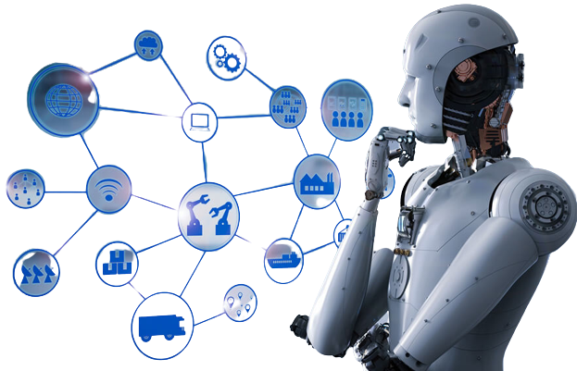
FUTURE SCOPE
There is an excellent scope of humanoids in the future as technology gets better every day.
Aviation Industry
Medical Industry
Agriculture
Transportation
Military sector

Slide 16
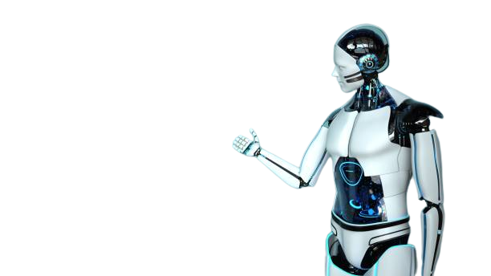
CONCLUSION
Humanoid robots have a great future. Currently, humanoids have constraints. They can function according to the algorithm that's added to their programs. Although some humanoid robots learn and work in real-time according to certain situations due to recurrent AI development, they still have limits. It's still a long way to go to bridge the gap.

Slide 17
REFERENCES
Humanoid History -WABOT- (waseda.ac.jp)
https://www.simplilearn.com/tutorials/artificial-intelligence-tutorial/humanoid-robots
https://en.wikipedia.org/wiki/Humanoid_robot

Slide 18
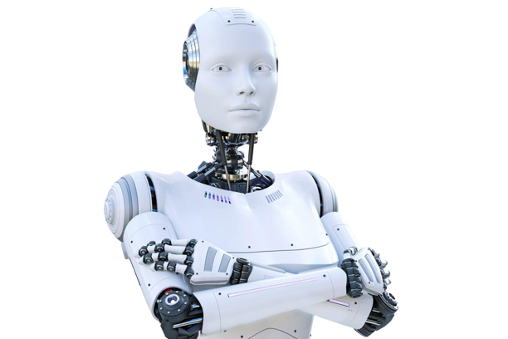
THANK YOU

